Slide 1
Warm up Becoming a Legal Writer
Exercise 10.5
See FACT PATTERN ON BLW p. 104-106 for context
The BRIEF ANSWER’s QUESTION PRESENTED IS EXAMPLE, 10.3 (page 239)
Review Tuesday’s slides for Brief Answer Standards and Examples

Slide 2
This is The Relevant ALABAMA Statue
Ala. Code § 13A-8-43 (2019)
§ 13A-8-43. Robbery in the third degree
(a) A person commits the crime of robbery in the third degree if in the course of committing a theft he:
  (1) Uses force against the person of the owner or any person present with intent to overcome his physical resistance or physical power of resistance; or
  (2) Threatens the imminent use of force against the person of the owner or any person present with intent to compel acquiescence to the taking of or escaping with the property.
(b) Robbery in the third degree is a Class C felony.

Slide 3
Brief Answer
Answers the Question Presented with a few sentences summarizing the reasons for the answer
Always contains:
A 1-2 word quick answer: Yes, No, Probably yes, Probably no
  “Maybe” is not acceptable
Reference to the legal standard/rules
The key LSFs
Your prediction

Slide 4
Today in LSS –Parentheticals and Statement of Facts
Statement of Facts
Conclusion
Parenthetical Use

Slide 5
ParentheticaLs

Slide 6
Weak and strong parentheticals
RULE 1.5
Weak | Stronger
(The court held that a mobile home was a habitation.) | (holding that a mobile home its owners had not yet moved into was a habitation because it held their bed and other furniture)
(finding the evidence insufficient) | (reversing an attempted-burglary conviction because the defendant's inexplicable conduct left reasonable doubt about his intent to commit theft)
(about lack of consent) | (holding that lack of consent may be proved circumstantially and that the complainant need not use “magic words”)
(“all of these factors are relevant; none are essential or necessarily dispositive”) | (“All of these factors are relevant; none are essential or necessarily dispositive.”)
The fixes: a lowercase participle, no period, the reason the case matters, and a capital letter and period inside the quotation marks for a full-sentence quote.
Bluebook (22d ed.) Rules 1.1–1.6 ·
12 / 15
Notes:
TIME: about 1 minute. This slide is a good one to trim if you are running long; the workshop's Task 3 covers the same ground. ROW BY ROW. 1. Trotter. Left: capital letter, a period, and a bare conclusion. Right: lowercase participle, no period, and the fact that links it to the Yukon (furnished with a bed and other furniture, owners not yet living there). Source: Trotter, 623 S.W.2d at 505. 2. Solis. Left: "finding the evidence insufficient" is true but tells the reader nothing about why. Right: it names the conviction reversed and the reason, which is the reason a memo writer would cite it as but see authority on intent. Source: Solis, 589 S.W.2d at 446–47. 3. Prescott. Left: a label, not a holding, and not a participle phrase. Right: the holding plus the court's own phrase "the magic words," which Prescott puts in quotation marks (610 S.W.2d at 762). Note how a short quoted phrase can ride inside an otherwise paraphrased parenthetical without changing the form. 4. Blankenship. Left: a full-sentence quote without the capital letter and period. Right: the corrected form. The sentence appears at 780 S.W.2d at 209. QUESTIONS TO ASK. "What does the reader learn from the stronger version that they do not learn from the weak one?" Students should answer in terms of facts and reasoning. Then ask: "If you wrote the weak version and the reader could not tell why you cited the case, which signal would you have been better off using?" (This is a gentle way to connect parentheticals back to signals.) DISCLAIMER YOU CAN SHARE. All four stronger versions are drawn from the text of the cases as you distributed them. Students writing their own should be able to point to the passage that supports their parenthetical.

Slide 7
Full illustration
Use when: it is your closest analogy and you plan to line up your facts closely with it.
Probable cause to prosecute depends on what the complainant reasonably believed when he filed the charge, not on whether the accused is later acquitted. Richey v. Brookshire Grocery Co., 952 S.W.2d 515, 517, 519 & n.1 (Tex. 1997). A store’s night manager saw Richey put a pack of cigarettes in his coat pocket and then pass through checkout, paying for his groceries but not the cigarettes. Id. at 516–17. Richey next bought baby food and left it in a charity bin. Id. at 517. When the manager confronted him in the parking lot, Richey said he had pocketed the cigarettes inadvertently and offered to pay. Id. The manager refused and later signed a sworn complaint charging Richey with theft. Id. A jury acquitted him. Id. The Texas Supreme Court held that the store had probable cause as a matter of law. Id. at 519–20. Because the manager saw Richey conceal the cigarettes and pass through checkout without paying for them, every objective element of theft reasonably appeared complete, and the store had no duty to investigate Richey’s state of mind before charging him. Id. at 518. Neither the charity donation nor the offer to pay negated the manager’s reasonable belief that Richey intended to take the cigarettes. Id. at 519.

Slide 8
Full illustration
Use when: it is your closest analogy and you plan to line up your facts closely with it.
Thesus or Hook. Probable cause to prosecute depends on what the complainant reasonably believed when he filed the charge, not on whether the accused is later acquitted. Richey v. Brookshire Grocery Co., 952 S.W.2d 515, 517, 519 & n.1 (Tex. 1997).
Legally Relevant Facts. A store’s night manager saw Richey put a pack of cigarettes in his coat pocket and then pass through checkout, paying for his groceries but not the cigarettes. Id. at 516–17. Richey next bought baby food and left it in a charity bin. Id. at 517. When the manager confronted him in the parking lot, Richey said he had pocketed the cigarettes inadvertently and offered to pay. Id. The manager refused and later signed a sworn complaint charging Richey with theft. Id. A jury acquitted him. Id.
Holding and Reasoning. The Texas Supreme Court held that the store had probable cause as a matter of law. Id. at 519–20. Because the manager saw Richey conceal the cigarettes and pass through checkout without paying for them, every objective element of theft reasonably appeared complete, and the store had no duty to investigate Richey’s state of mind before charging him. Id. at 518. Neither the charity donation nor the offer to pay negated the manager’s reasonable belief that Richey intended to take the cigarettes. Id. at 519.

Slide 9
Short illustration
Use when: the facts show why the rule applies, but it’s not your main case.
Probable cause to prosecute depends on what the complainant reasonably believed when he filed the charge, not on whether the accused is later acquitted. Richey v. Brookshire Grocery Co., 952 S.W.2d 515, 517, 519 & n.1 (Tex. 1997). A night manager watched a customer put cigarettes in his coat pocket and pass through checkout without paying for them. Id. at 516–17. The court held that the store had probable cause, because the customer’s charity donation and offer to pay did not negate the manager’s reasonable belief that he meant to take the cigarettes. Id. at 519–20.
Keep the Thesus, only the facts you will compare, and a sentence of Holding and Reasoning. Some are even shorter than this example.

Slide 10
Parenthetical
Use when: bolstering a rule or you are just making one factual point. Keep only the holding, as one phrase that begins with a present participle.
Rule-focused
Richey v. Brookshire Grocery Co., 952 S.W.2d 515, 517 (Tex. 1997) (explaining that probable cause asks whether a reasonable person would believe a crime was committed, given the facts as the complainant honestly and reasonably believed them to be when the prosecution began).
Fact-focused
Richey v. Brookshire Grocery Co., 952 S.W.2d 515, 519–20 (Tex. 1997) (holding that a store had probable cause to charge a customer with theft after its manager saw him pocket cigarettes and pass through checkout without paying, despite his offer to pay).
Common mistake: a parenthetical that is really a paragraph. If it runs past two lines, make it a short illustration.

Slide 11
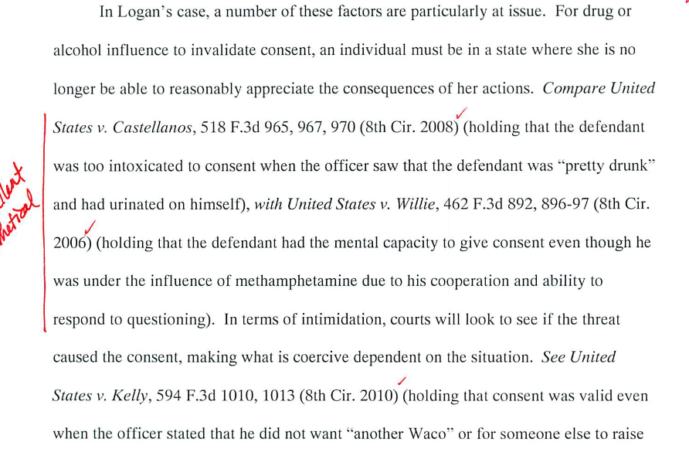

In A rule statement

Slide 12
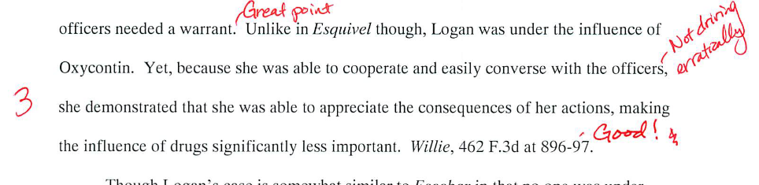
Then in analysis. . .

Slide 13
Choosing among the three
Ask | Then use
Is this case central to your analysis? | A full illustration
Do a few key facts show why the rule applies? | A short illustration
Is there just one factual comparison you need from the case? | A parenthetical
Do several cases make the same point? | Illustrate the best one; cite the rest with parentheticals

Slide 14
Statement of Facts

Slide 15

Build a foundation for your argument.
In the first paragraph, set the context → who are the parties? –what is their status?
Then include all legally significant facts as well as background facts to contextualize them.
Include both good and bad facts.
Use this opportunity to begin advancing your theory of the case.
Write in an objective tone; now is not the time for arguing.
Notes:
Your statement of facts is like the foundation of a house. Just like it wouldn’t work to pour cement for every room except one, it doesn’t work to leave pivotal facts out of your statement.
If the fact is relevant to the cause of action, then it needs to be in your statement of facts. Surprising the court with an undisclosed fact in the argument section doesn’t work well.
You should include all of the legally significant facts – what facts will you rely on to prove your claim or defense, or to disprove the other side’s argument? All of these facts need to be in your statement of fact, together with background information that helps to contextualize the facts.
You must include both good and bad facts. If you have a contract case, and your client failed to deliver the contracted for goods by the delivery date, admit it. Don’t highlight it! But ignoring bad facts does not make them go away – it just makes you look like an untrustworthy narrator and thus diminishes your credibility or ethos. It also gives the opposing party the first chance to characterize the facts – and they will probably do it in a way that is the most damaging to you.
Although you may elect to include certain facts in order to set an emotional tone or elicit empathy, and although you will relate your facts in a way that favors your client and case theory, you must be objective. That means avoid editorializing and using adjectives and adverbs. Any attempt to evoke emotion must be VERY subtle.

Slide 16
Statement of Facts
  Do not simply repeat the facts from the assignment
  Include LSFs and relevant background facts to provide context
  Organize the facts coherently
    Chronologically
    By Topic
    Both
Be precise, neutral, and accurate; no argument—just report what happened.
  All facts referred to in the Discussion Section must be in the Statement of Facts

Slide 17
Statement of Facts
First Paragraph―identify your client and briefly describe client’s problem
Middle Paragraphs―present story behind legal dispute
Last Paragraph―describe the current status of the case, including the procedural posture (where are we now)
Notes:
Chronological
Organize facts in the order in which the events occurred
Easiest to read
Topical
Present facts according to the discrete issues you need to address
Example:
(1) Whether expert witness has qualifications to testify.
(2) Whether expert’s affidavit conforms to rules of procedure

Slide 18
Don’t exaggerate or sensationalize the facts
  Don’t: Lillian chatted away on her cell phone while her son tempted fate by skateboarding without a helmet.
  Do: Lillian called her husband to drop off the helmet; at the same time, James began skateboarding.
Don’t sugar coat the facts (include bad facts)
  Don’t: James took a little tumble on his skateboard.
  Do: James sustained a skull fracture and developed a blood clot.

Slide 19
  What NOT to do: Mrs. Jones drove negligently through the school zone.
  Better: Mrs. Jones drove 35 mph through the school zone. The posted speed limit was 15 mph.
  ** “Negligently” is a legal conclusion. **

Slide 20
Examples& Practice
Read both Peter Bein and Koogs Brewery Memos in the Week 9 Canvas Modules for good examples of Statement of Facts.
Let’s review BLW Exercise 11.2 & 11.5

Slide 21
What do you think makes for a good conclusion?

Slide 22
Conclusion
The Conclusion summarizes your prediction in a conclusory manner. Often, it is helpful to go one step further and offer advice or a recommendation for action.
How does our memo provide an opportunity for client advise?

Slide 23
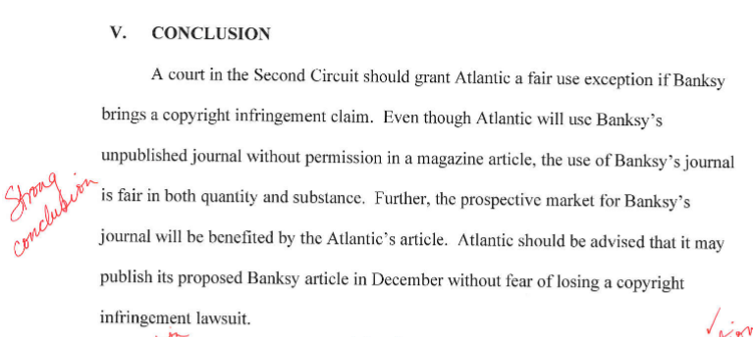
Conclusion Example

Slide 24

Homework
Work on Final Memo
Read BLW Ch. 13 (pp. 285-289); complete Ch. 13 exercises 13.1, 13.2, 13.4 and 13.5

